Slide 1



Center of Excellence For AI and Robotics
Introductory Seminar 2020

Slide 2
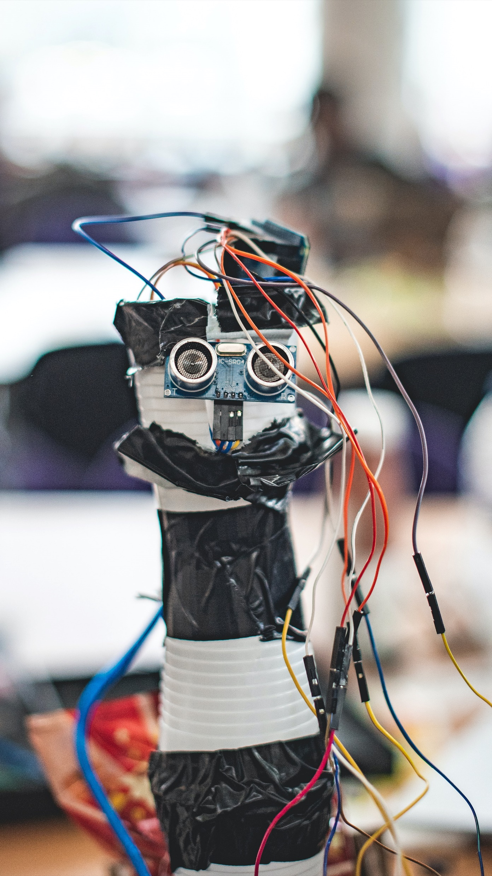

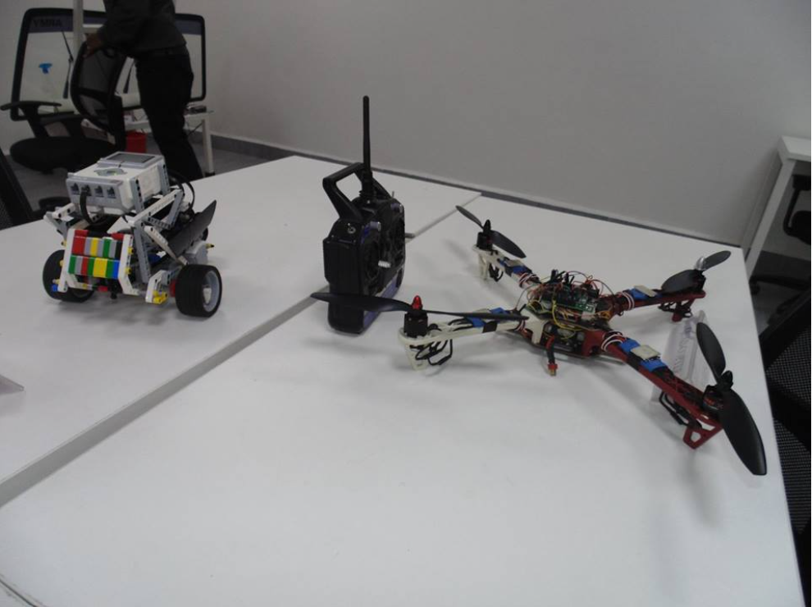
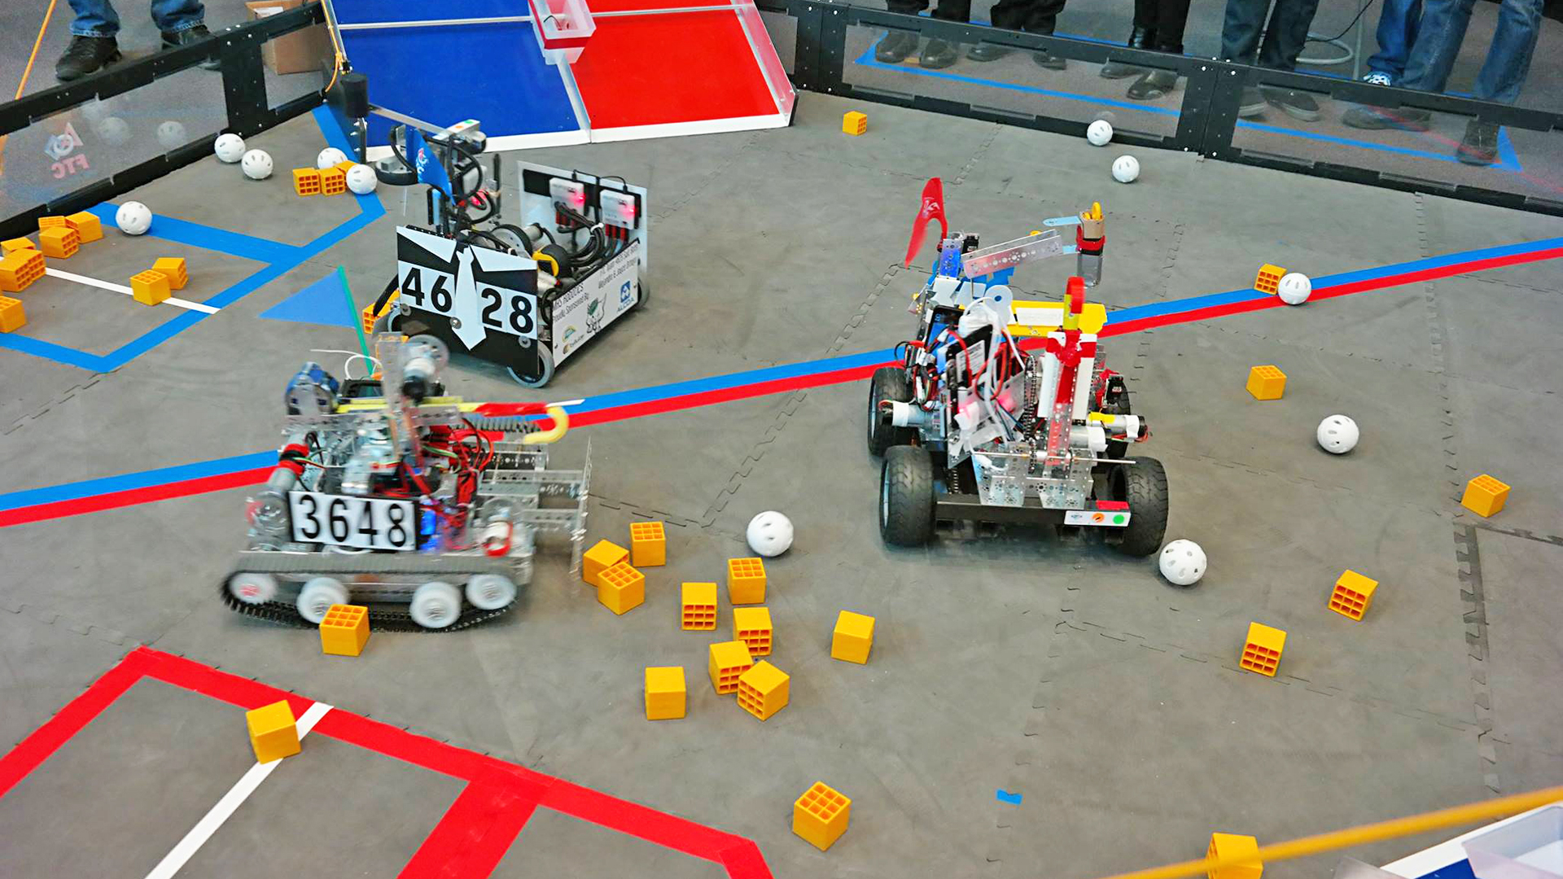
A little bit of Intro…
The Center of Excellence For AI and Robotics or better known as the Robotics Club is one of the prestigious Clubs of AIT.

Slide 3
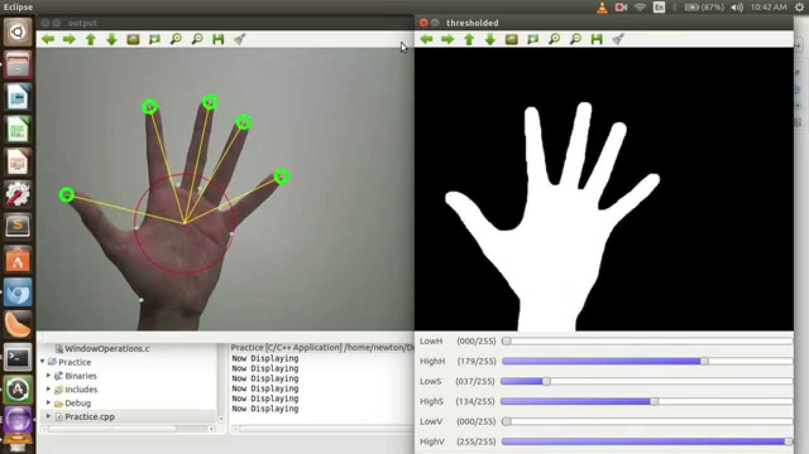
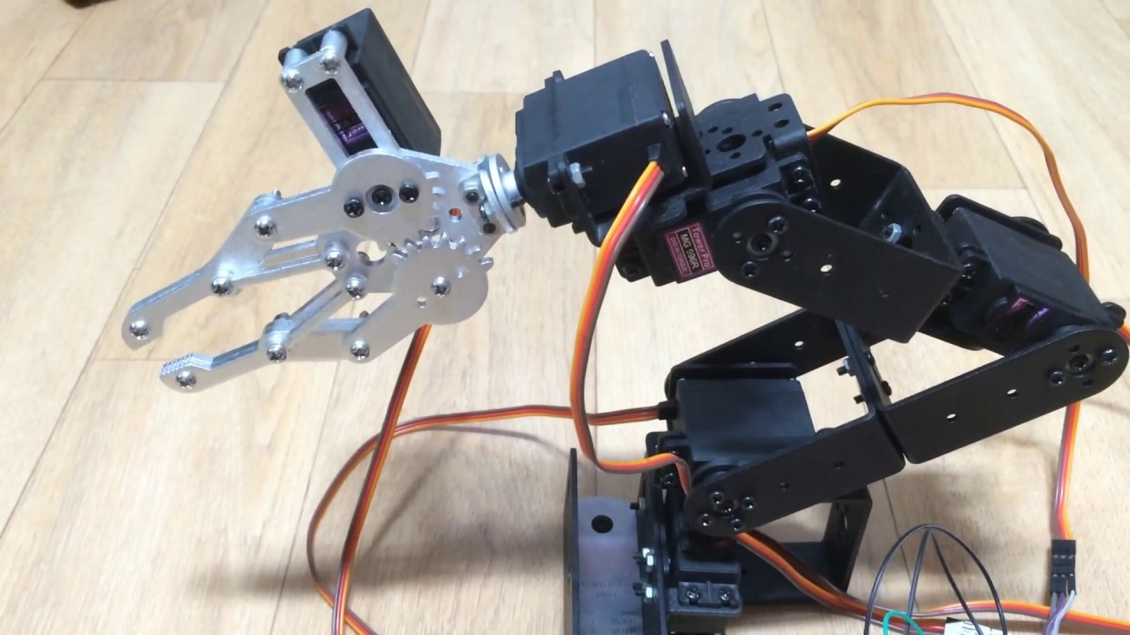
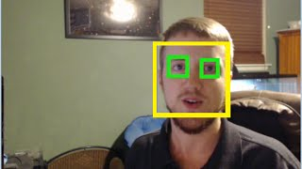
A little bit of Intro…
The robotics club sheds its major focus on building ecosystems for budding engineers to thrive in the fields of robotics.
Till the year before the previous year, we majorly focused on electronics and the mechanical aspects of robot building but as the trends have refreshed, it was important for us to welcome potential programming domains such as AI and ML.

Slide 4
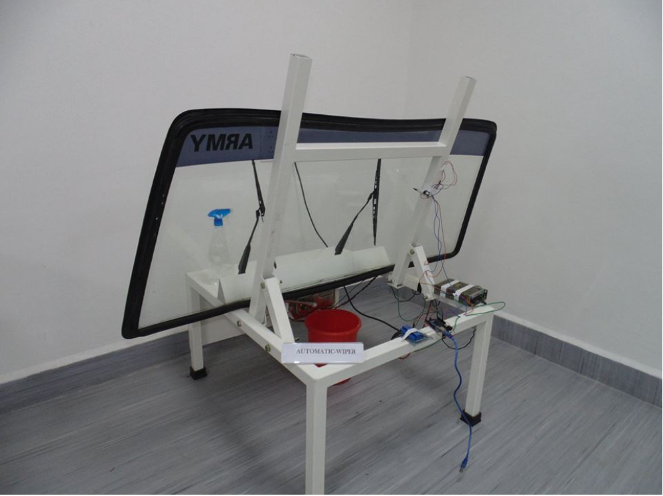
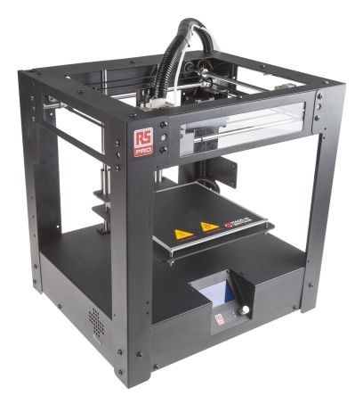
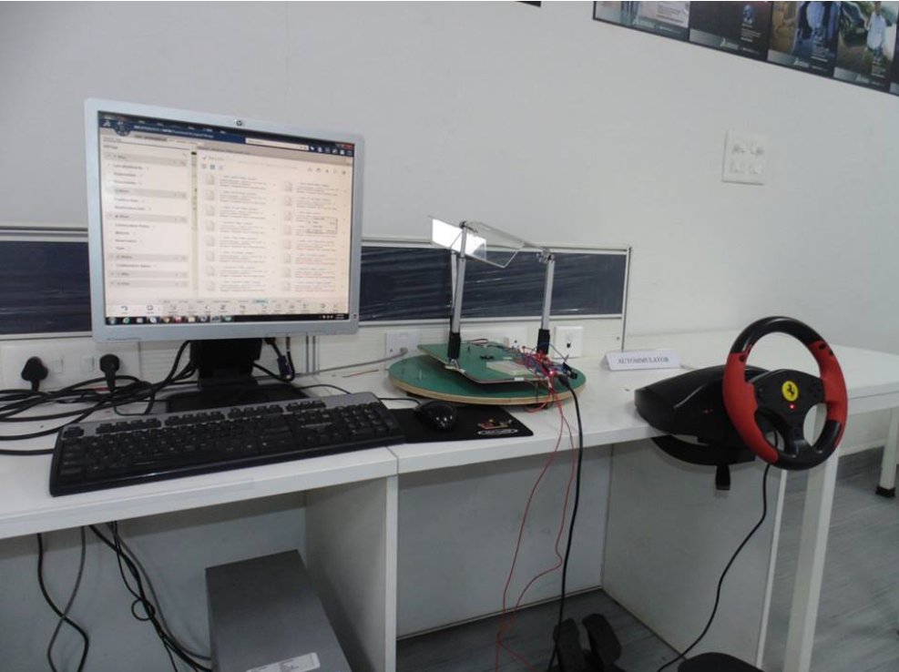
A little bit of Intro…
The robotics club also dissolved the advanced 3dPLM lab under itself last year and thus all projects and all tools such as the 3d printer are now available to use under the robotics club to all members and interested individuals.

Slide 5

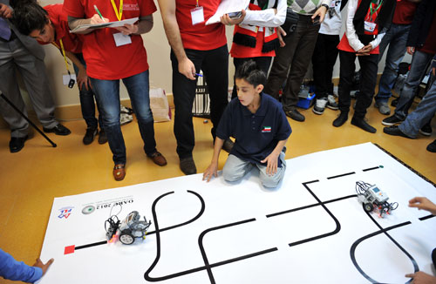

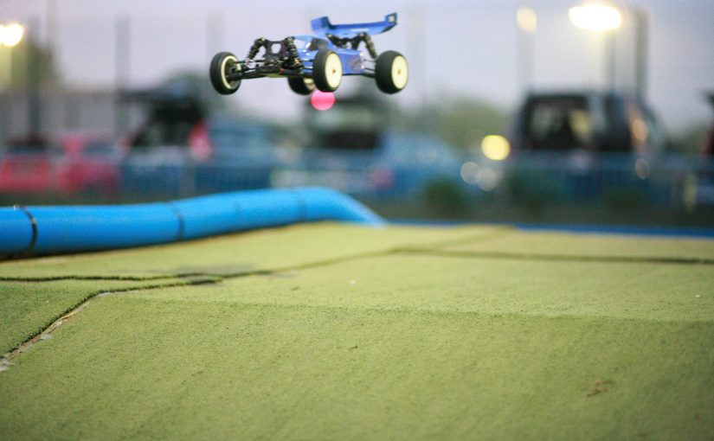
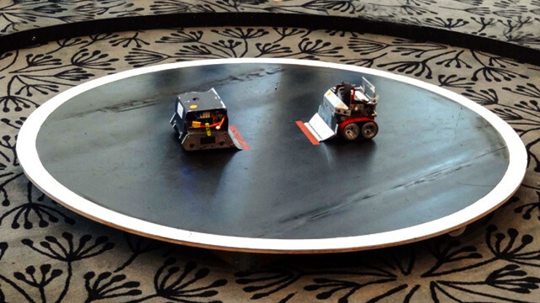
Competitions
The teams from the robotics club represent the college at various robotics competitions held by other colleges and institutions all over the country.

Slide 6

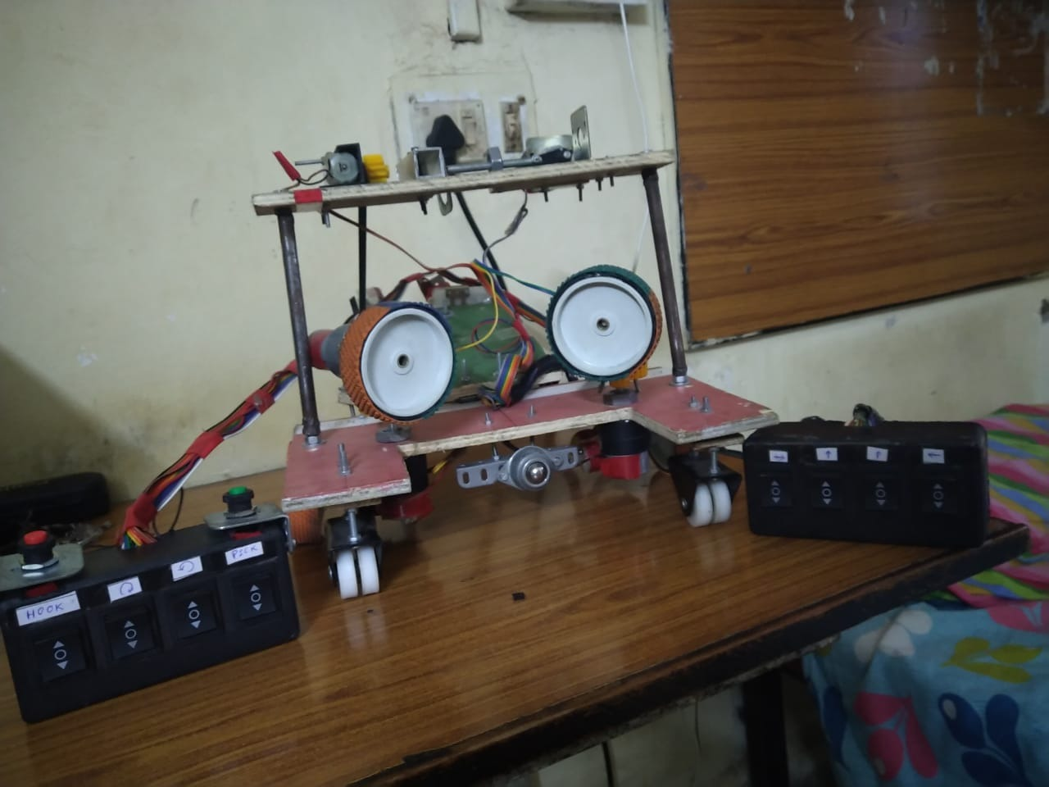
Competitions
Escalade – Techniche – IIT Guwahati
The AIT Robotics Club has repeatedly proved its ground at events such as Escalade , which is the major robotics event of Techniche (Techfest of IIT Guwahati), consistently winning top 3 for the last 5-6 years.
We are also the center of prelims selection for the same.

Slide 7

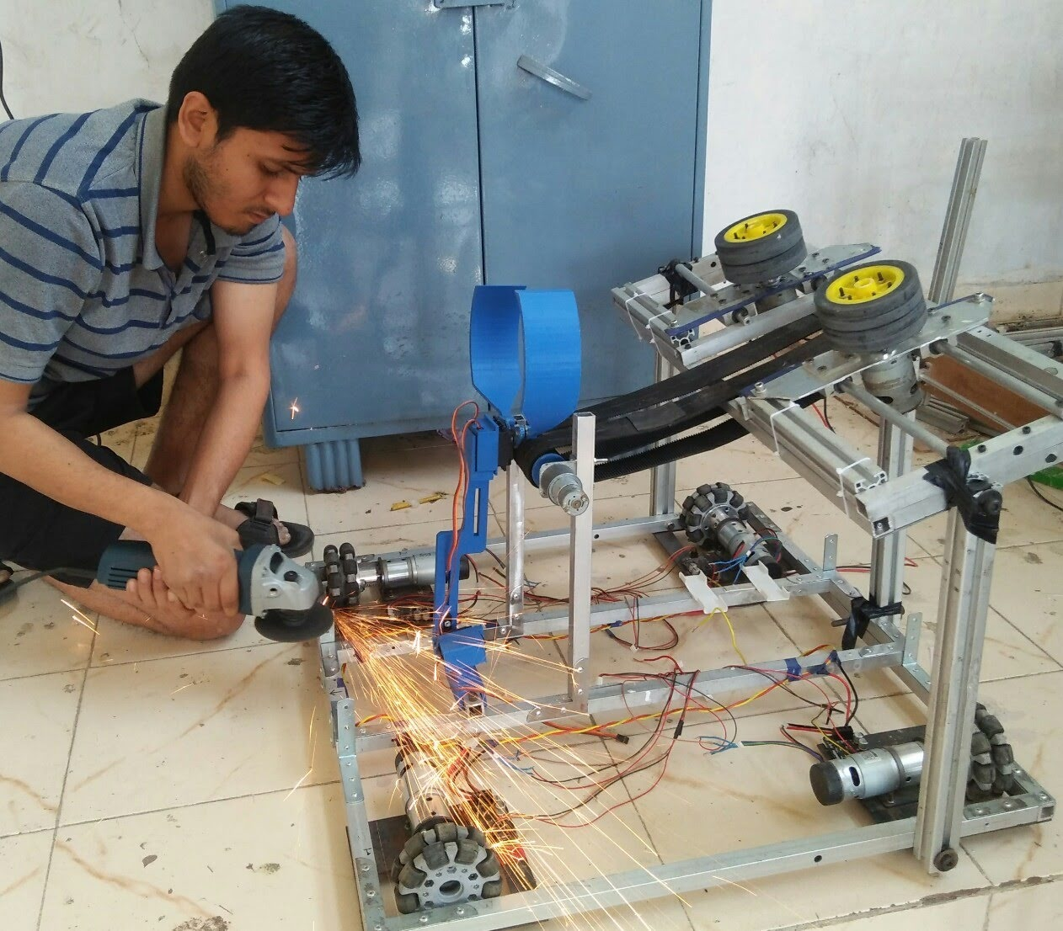
Competitions
ABU - Robocon
We are top scorers and qualifiers at the Asia Pacific Robocon , state level.
We have improved over the years learning from our mistakes.
This year we scored top 5 in the first round all over the country, finals to be held in IIT Delhi.

Slide 8

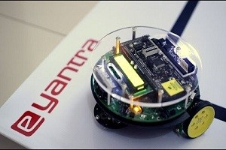
Competitions
E-yantra IITB
Eyantra Robotics competition is the pinnacle of advanced robotic tournaments in India.
Every Year a number of teams are selected for the hardware round gaining experience and knowledge along the way.

Slide 9

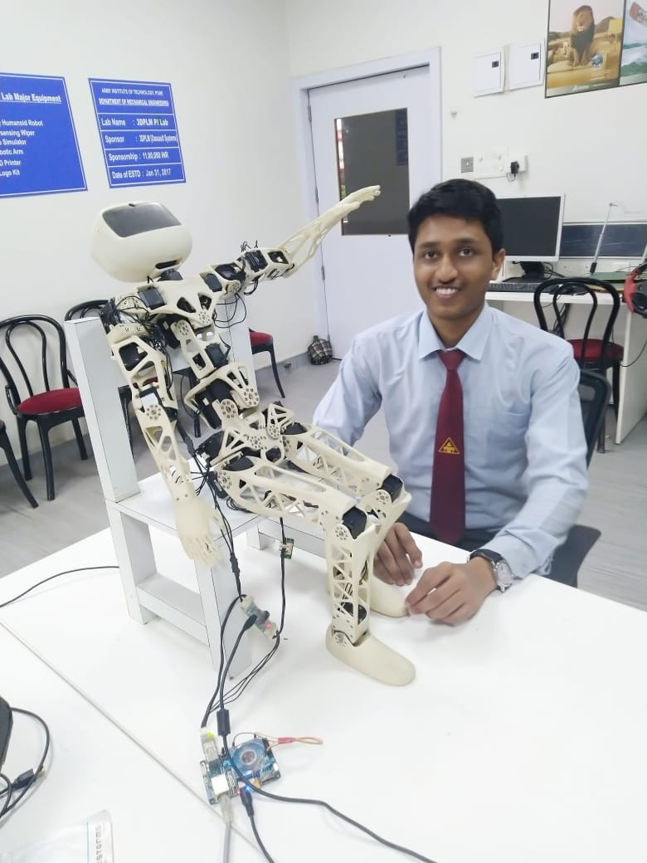
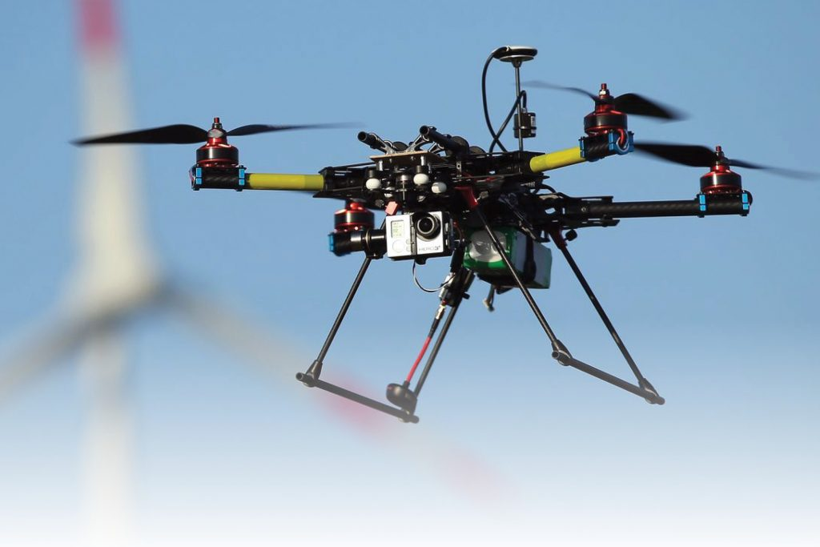
Projects
The club works on major projects every year and represents them in various competitions on behalf of the college.
The club also considers it of due importance that individual projects are given proper guidance and incubation.
The interested members who want to work on special projects are provided help from the club , in various forms such as item selection, cost analysis and overall planning.

Slide 10

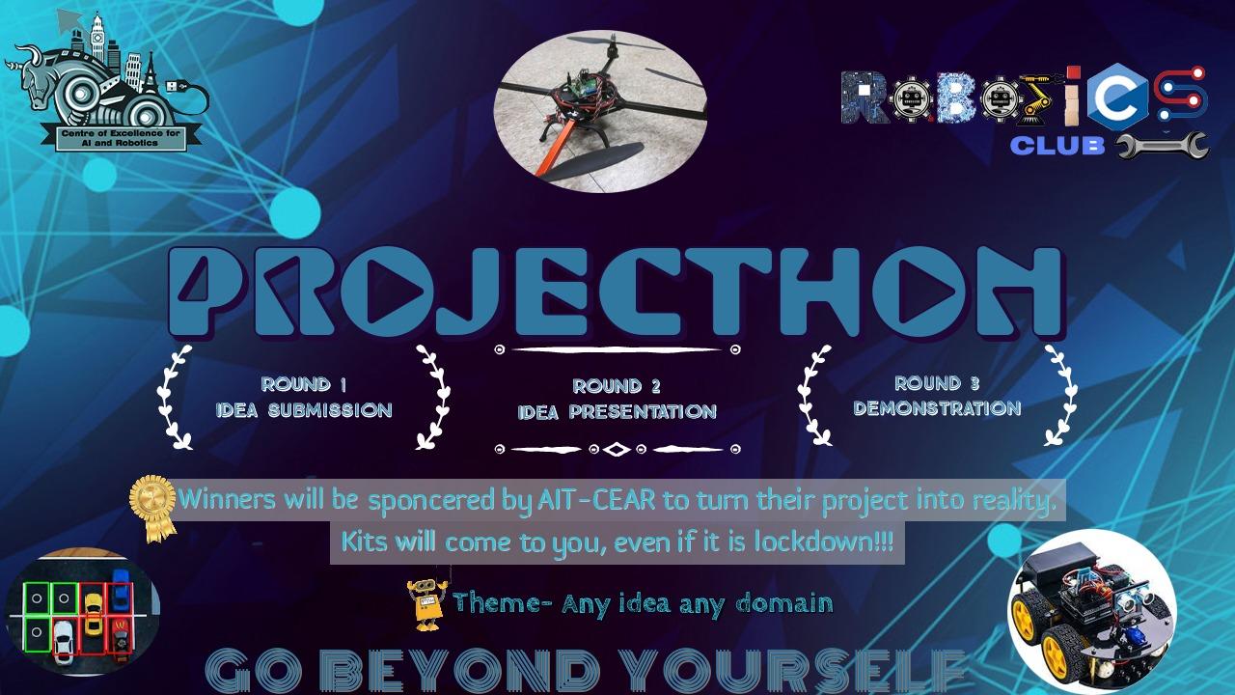
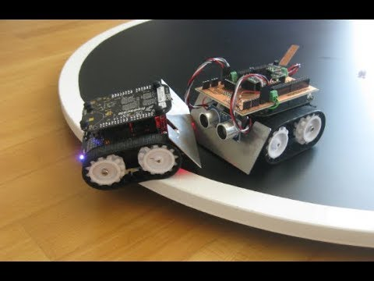
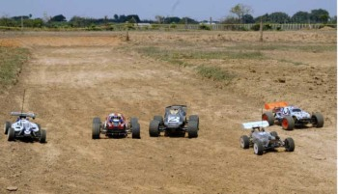
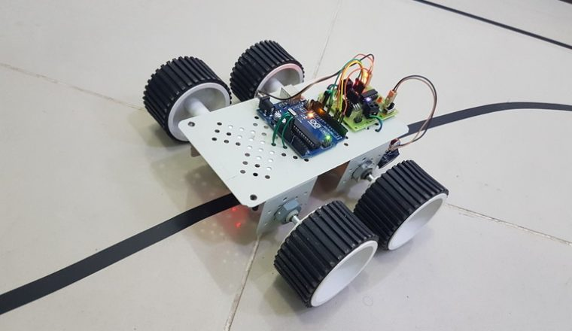
In-College Events
The club organizes events and competitions around the year both interbranch and intercollege.
We even hold workshops and sessions for the interested students on robotics and similar fields, inviting prestigious alumni and professionals as speakers from other colleges or companies.

Slide 11
Thank You
Introductory Seminar 2020

